Slide 1



Animal Faces
Deep Learning Images Classification

Slide 2
0 1
INTRO

Slide 3
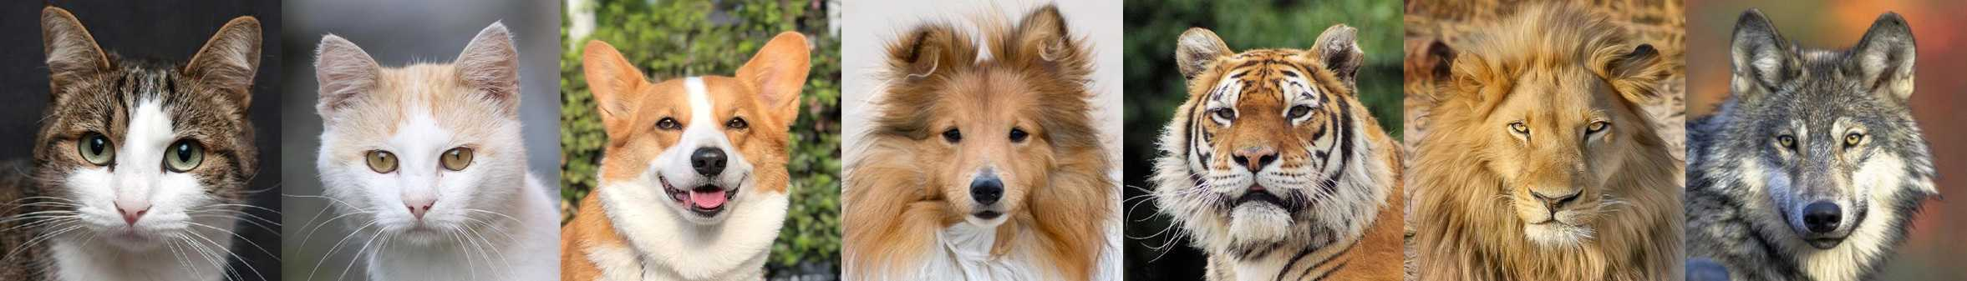
WHY?
Images AI Usage
Recognition : detect human faces ID to unlock the phone
Classification: facial expression to identify human emotions
What about animals?
Can it be used and benefit in any place?

Slide 4
WHO? HOW?
Use Cases
pet shops
animal shelters
zoos
fully self-driving car camera system
Deep Learning
Neuron Network
RGB color images
images classification

Slide 5
0 2
DATA

Slide 6
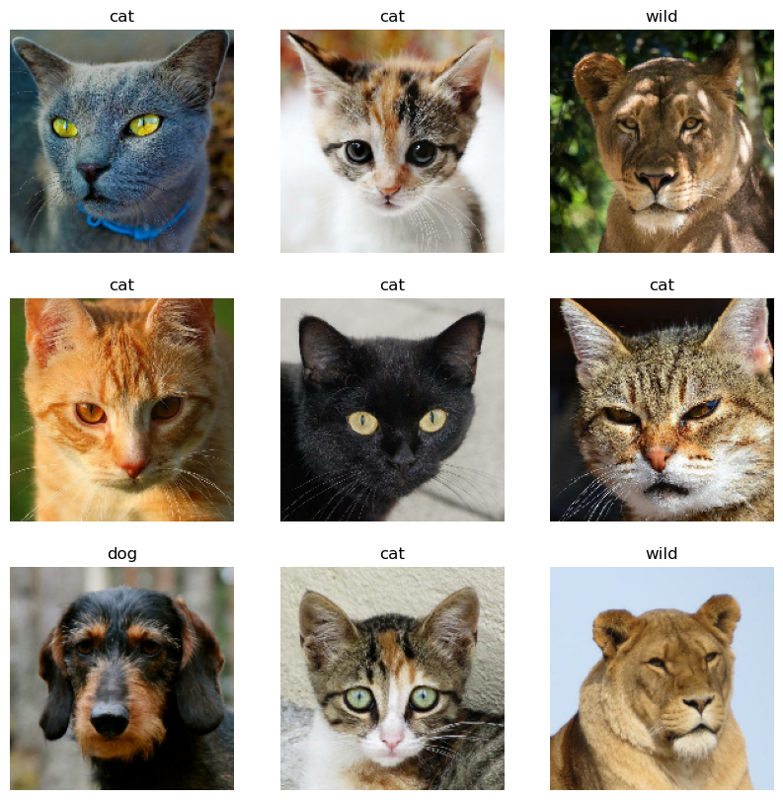
Data Collection
Resource
Kaggle
Image quality
HQ 512 x 512
Close up face only
Pre-split datasets
Test & Validation
sorted by each class label

Slide 7
EDA
Train dataset
14630 images
-> 3 classes
10: 1
Validation dataset
1500 images
-> 3 classes

Slide 8
EDA 3 Classes Distribution
No Class imbalance issue
35.22%
32.39%
32.38%
45%
Cats
Dogs
Wildlife

Slide 9
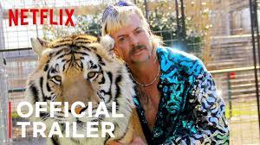
EDA 3 Classes Distribution
No Class imbalance issue
35.22%
32.39%
32.38%
45%
Cats
Dogs
Wildlife

Slide 10
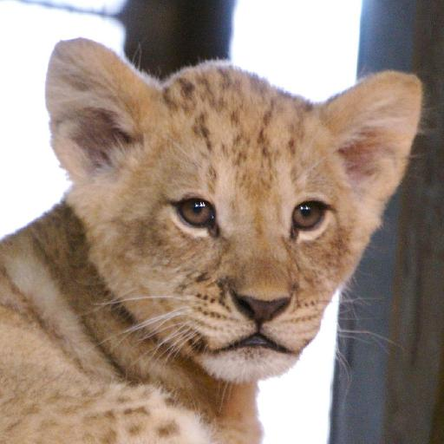
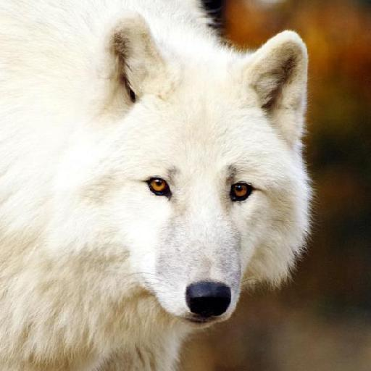
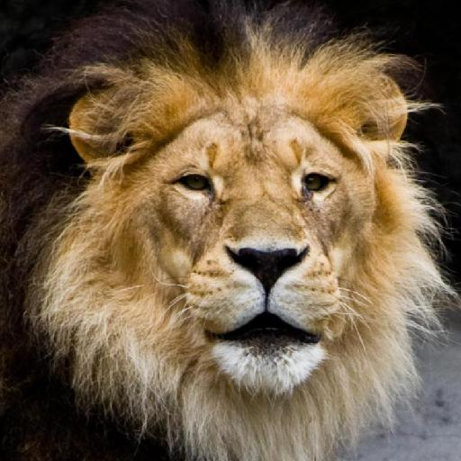
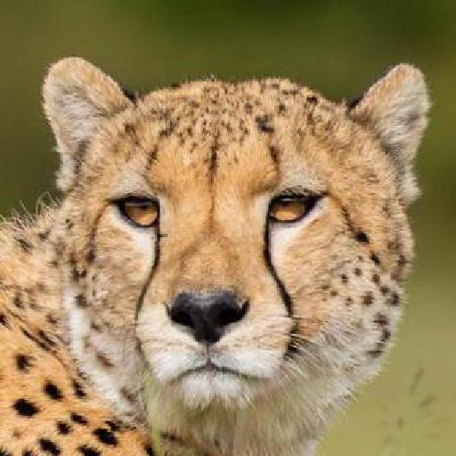
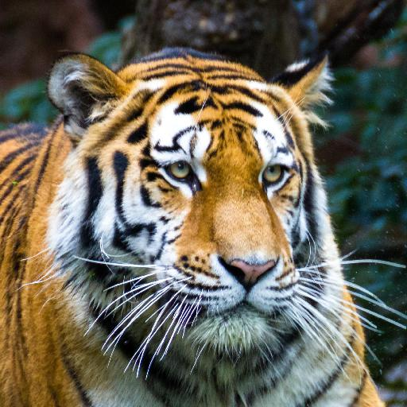
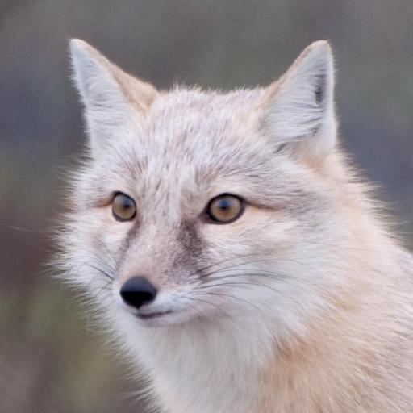
Wildlife

Slide 11
0 3
APPROACH

Slide 12
Workflow
02
Baseline CNN
Load images
from directories
Dropout (0.950 accuracy)
EarlyStopping
ReduceLROnPlateau (0.965 accuracy)
01
Data
Preprocessing
04
Keras Preprocessing
ImageDataGenerator
Set images size 150 x 150
Transfer Learning
Image Augmentation
0.988 accuracy
03
Trained features on VGG16
Used as base for CNN
ReLu + Softmax Activation

Slide 13
Workflow
02
Baseline CNN
Load images
from directories
0.969 accuracy
Conv2D + Maxpooling
Different size of filters : 32 , 64 , 128
Kernel kept at 3
Flatten
ReLu Activation for hidden layers
Softmax for output layers (Multiclass)
CNN (0.950 accuracy)
EarlyStopping
Fully Connected Layers)
01
Data
Preprocessing
04
Keras Preprocessing
ImageDataGenerator
Set images size 150 x 150
Transfer Learning
Image Augmentation
0.988 accuracy
03
Trained features on VGG16
Used as base for CNN
ReLu + Softmax Activation

Slide 14
Workflow
02
Baseline CNN
Load images
from directories
0.969 accuracy
Conv2D + Maxpooling
Different size of filters : 32 , 64 , 128
Kernel kept at 3
Flatten
ReLu Activation for hidden layers
Softmax for output layers (Multiclass)
Dropout (0.950 accuracy)
EarlyStopping
ReduceLROnPlateau (0.965 accuracy)
01
Data
Preprocessing
04
Keras Preprocessing
ImageDataGenerator
Set images size 150 x 150
03
Transfer Learning
0.993 accuracy
Image Augmentation
0.988 accuracy
Trained features on VGG16
Used as base for CNN
ReLu + Softmax Activation
Notes:
I also tried Dropout and Early Stopping but the score dropped a bit so I didn’t continue this way

Slide 15
Workflow
02
Baseline CNN
Load images
from directories
0.969 accuracy
Conv2D + Maxpooling
Different size of filters : 32 , 64 , 128
Kernel kept at 3
Flatten
ReLu Activation for hidden layers
Softmax for output layers (Multiclass)
Dropout (0.950 accuracy)
EarlyStopping
ReduceLROnPlateau (0.965 accuracy)
01
Data
Preprocessing
04
Keras Preprocessing
ImageDataGenerator
Set images size 150 x 150
03
Transfer Learning
0.993 accuracy
Image Augmentation
0.988 accuracy
Trained features on VGG16
Used as base for CNN
ReLu + Softmax Activation
Notes:
0. Training Learning VGG16 seems doing pretty well here. Accuracy 99.3%

Slide 16
Workflow
02
Baseline CNN
Load images
from directories
0.969 accuracy
Conv2D + Maxpooling
Different size of filters : 32 , 64 , 128
Kernel kept at 3
Flatten
ReLu Activation for hidden layers
Softmax for output layers (Multiclass)
Dropout (0.950 accuracy)
EarlyStopping
ReduceLROnPlateau (0.965 accuracy)
01
Data
Preprocessing
04
Keras Preprocessing
ImageDataGenerator
Set images size 150 x 150
03
Transfer Learning
0.993 accuracy
Image Augmentation
0.988 accuracy
Trained features on VGG16
Used as base for CNN
ReLu + Softmax Activation
Used VGG16 as base
Used train-datagen for image cropping
ReLu + Softmax Activation
Notes:
Image Augmentation didn’t outperform my transfer learning
Ac

Slide 17
Workflow
02
Baseline CNN
Load images
from directories
0.969 accuracy
Conv2D + Maxpooling
Different size of filters : 32 , 64 , 128
Kernel kept at 3
Flatten
ReLu Activation for hidden layers
Softmax for output layers (Multiclass)
Dropout (0.950 accuracy)
EarlyStopping
ReduceLROnPlateau (0.965 accuracy)
01
Data
Preprocessing
04
Keras Preprocessing
ImageDataGenerator
Set images size 150 x 150
03
Transfer Learning
0.993 accuracy
Image Augmentation
0.988 accuracy
Trained features on VGG16
Used as base for CNN
ReLu + Softmax Activation
Used VGG16 as base
Used train-datagen for image cropping
ReLu + Softmax Activation
Notes:
Image Augmentation didn’t outperform my transfer learning
Ac

Slide 18
0 4
RESULT

Slide 19
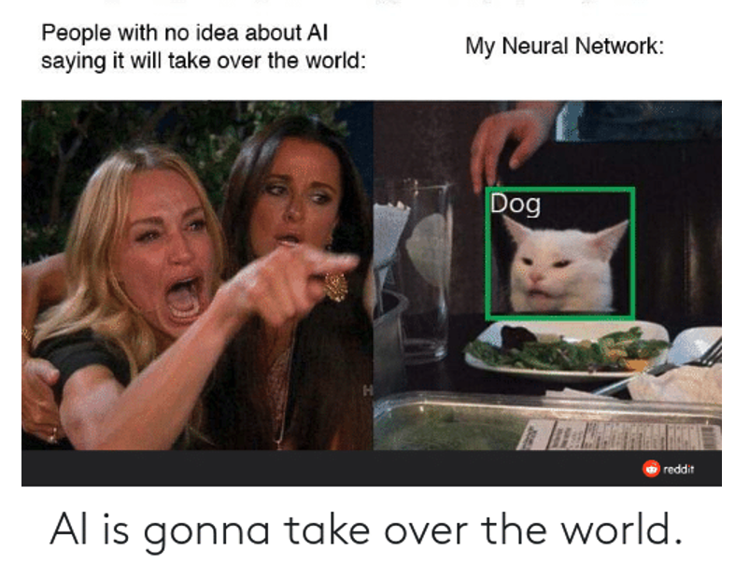
App
MEME
(just for fun and it’s not my model pred)
model
web app
streamlit
http://192.168.0.121:8501
Notes:
I deploy my model to a web app by using streamlit
Here’s a AI meme, said ppl worry about AI will take over the world, but meanwhile My Neural Network classifying a cat as a dog…We’ll see if that will happen on my app

Slide 20
0 5
FUTURE WORK

Slide 21
Coming Soon
Facial Detection
+
GAN
generate AI animal faces
Add more breeds data for modeling
Video
Enable
Features
Notes:
For future work, I will want to refine my app to add more functions or try GAN to generate AI animal faces

Slide 22
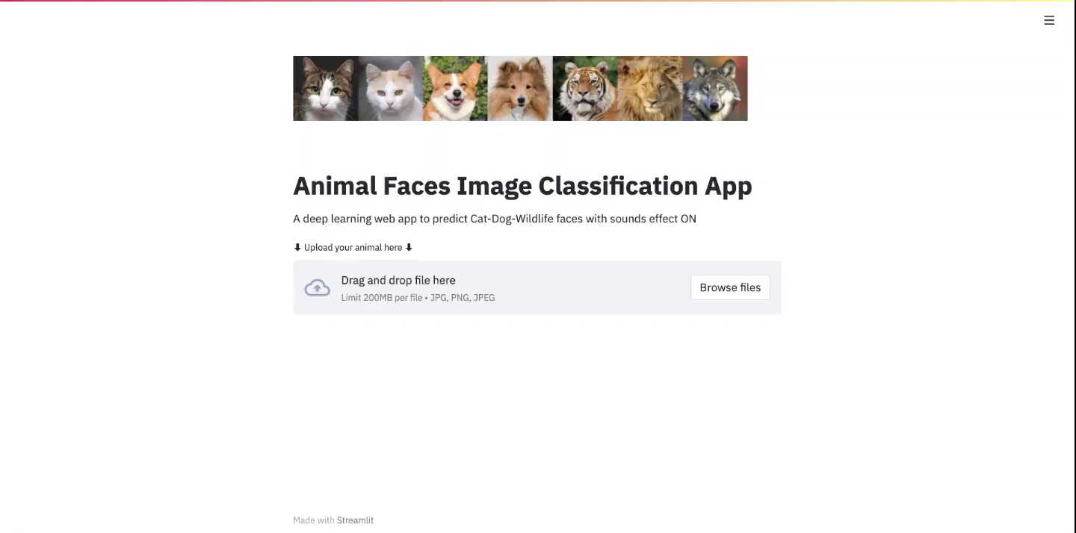
Demo
Notes:
07:07

Slide 23
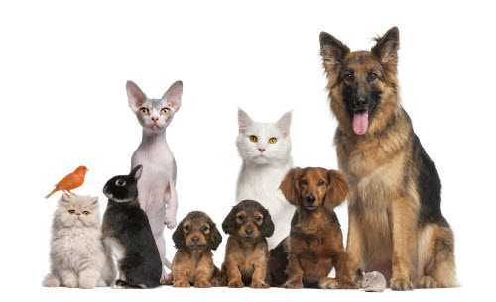
Thanks!
Do you have any questions?
addyouremail@freepik.com
+91 620 421 838
yourcompany.com

Slide 24
0 6
APPENDIX

Slide 25
0 6
APPENDIX

Slide 26
Deep Learning Tools
Keras
accuracy
score
Load Images
os.path & glob
get data from
path folders
Convolutional Neuron
Network
(CNN)

Slide 27
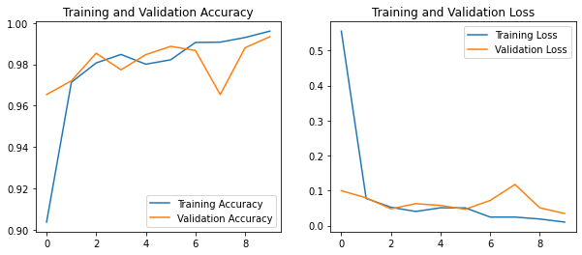
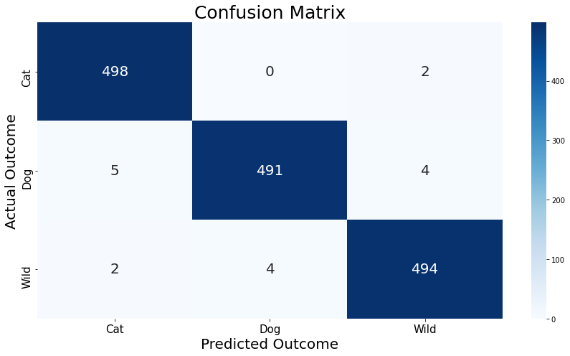
Accuracy & Loss Confusion Matrix
Final Model
Epochs = 10
Notes:
Confusion Matrix: get 17 wrong predictions out of 1500 samples in Validation set

Slide 28
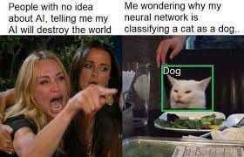
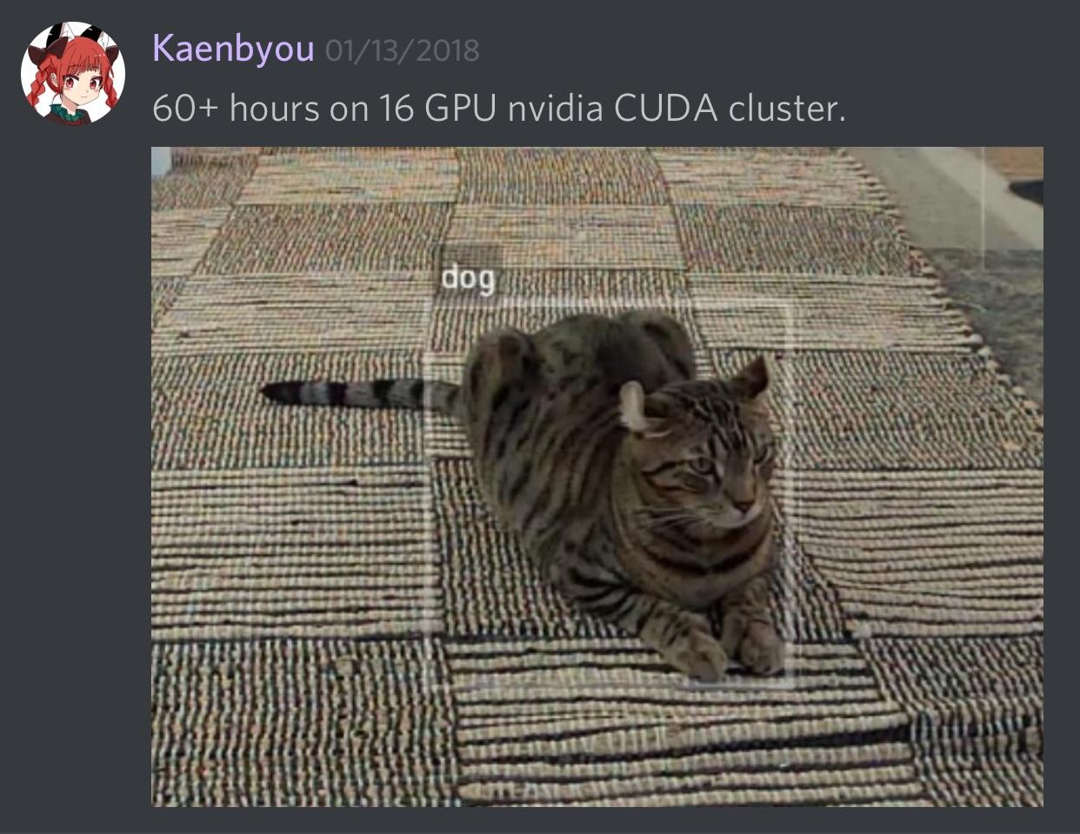
Meme

Slide 29
Table of Contents
0 1
0 2
0 3
0 4
0 5
Intro
Data
Approach
Use cases
EDA
Neuron Network modeling
Result
Future Work
Web app deployment
Refine goals

Slide 30
Animal Faces
Deep Learning Images Classification

Slide 31
Animal Faces
Deep Learning Images Classification

